Slide 1

Understand Binary Representation
Understand Addresses and Pointers
Understand Boolean Algebra
Bits and Bytes
① Bits and Bytes
② Addressing
③ Boolean Algebra
Notes:
Last update: 14 Dec 2015

Slide 2
Hardware: Logical View
CPU
Register file
ALU
System bus
PC
Memory bus
I/O
bridge
Main
memory
Bus interface
I/O bus
Expansion slots for
other devices such
as network adapters
USB
controller
Graphics
adapter
Disk
controller
Keyboard
Disk
Mouse
Display

Slide 3
Programmer’s View
CPU
Memory
Object Code
Program Data
OS Data
Address
Registers
Data
Condition Codes
Instructions
Program Counter
Stack

Slide 4
Binary Representation
0
1
0
3.3V
2.8V
0.5V
0.0V
Bi
nary digi
t

Slide 5
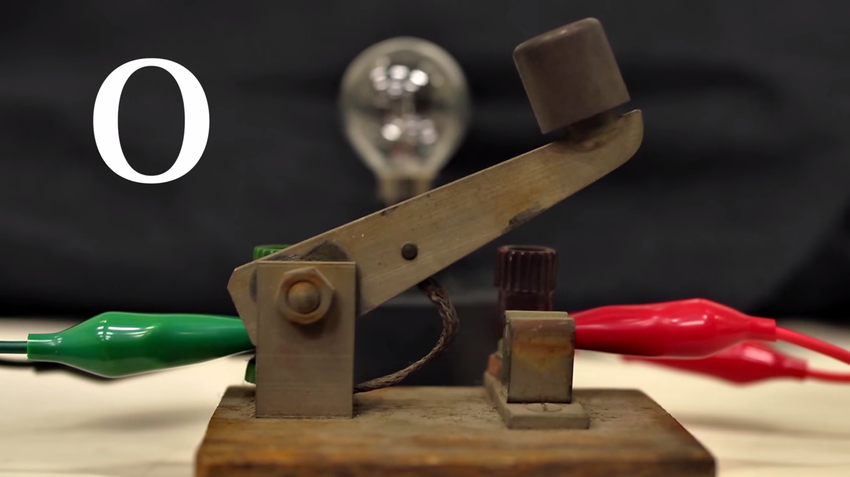
Notes:
On and off can be represented by a switch
Same with a light bulb

Slide 6
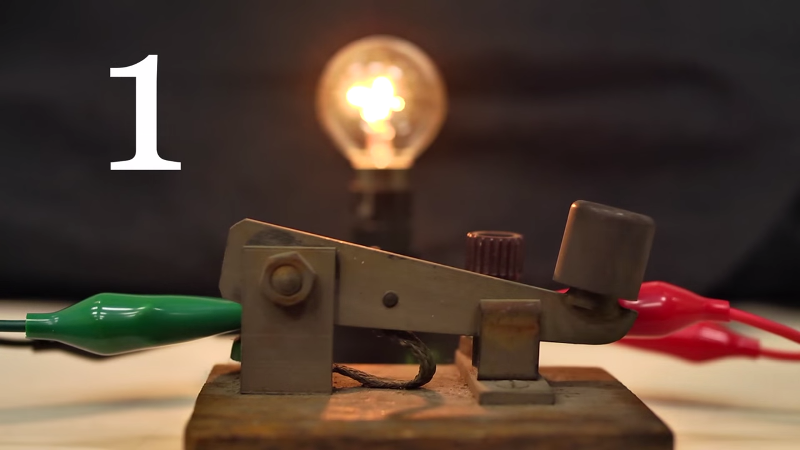

Slide 7
Binary |  |  |  | Dec
0 | 0 | 0 | 0 | 0
0 | 0 | 0 | 1 | 1
0 | 0 | 1 | 0 | 2
0 | 0 | 1 | 1 | 3
0 | 1 | 0 | 0 | 4
0 | 1 | 0 | 1 | 5
0 | 1 | 1 | 0 | 6
0 | 1 | 1 | 1 | 7
Binary |  |  |  | Dec | Hex
0 | 0 | 0 | 0 | 0 | 0
0 | 0 | 0 | 1 | 1 | 1
0 | 0 | 1 | 0 | 2 | 2
0 | 0 | 1 | 1 | 3 | 3
0 | 1 | 0 | 0 | 4 | 4
0 | 1 | 0 | 1 | 5 | 5
0 | 1 | 1 | 0 | 6 | 6
0 | 1 | 1 | 1 | 7 | 7
Binary |  |  |  | Dec
1 | 0 | 0 | 0 | 8
1 | 0 | 0 | 1 | 9
1 | 0 | 1 | 0 | 10
1 | 0 | 1 | 1 | 11
1 | 1 | 0 | 0 | 12
1 | 1 | 0 | 1 | 13
1 | 1 | 1 | 0 | 14
1 | 1 | 1 | 1 | 15
Binary |  |  |  | Dec | Hex
1 | 0 | 0 | 0 | 8 | 8
1 | 0 | 0 | 1 | 9 | 9
1 | 0 | 1 | 0 | 10 | A
1 | 0 | 1 | 1 | 11 | B
1 | 1 | 0 | 0 | 12 | C
1 | 1 | 0 | 1 | 13 | D
1 | 1 | 1 | 0 | 14 | E
1 | 1 | 1 | 1 | 15 | F

Slide 8
No. of bit | Max Value | C C++
1 | 1
2 | 3
4 | 15
8 | 255 | char
16 | 65,535 | short
32 | ~4.3B | int
64 | ~18BB | long
byte
DE
1 1 0 1 1 1 1 0
8 bits

Slide 9
Memory Organization
word
word
1F
CA
75
EE
5B
12
DC
A7
EA
75
B1
2D
F1
EE
F1
EE
• • •
DE
AD
BE
EF
00…0
00…8
00…C
FF…F
address
location in memory

Slide 10
Memory Organization
1F
CA
75
EE
5B
12
DC
A7
EA
75
B1
2D
F1
EE
F1
EE
• • •
DE
AD
BE
EF

Slide 11


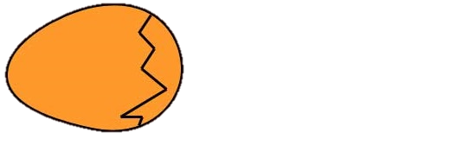

Byte Ordering
1FCA75EE5B12DCA7
Big-Endian
A7DC125BEE75CA1F
00…00
1F
CA
75
EE
5B
12
DC
A7
Little-
Endian
00…08
EA
75
B1
2D
F1
EE
F1
EE
00…10
00
00
00
00
00
00
00
08
08
00
00
00
00
00
00
00
• • •
49
6C
6F
76
65
55
00
00
18
00
00
00
00
00
00
00
DE
AD
BE
EF
DE
AD
BE
EF

Slide 12
Examining Data Representations
void show_bytes(char *start, int len) {
int i;
for (i = 0; i < len; i++)
printf("%p\t0x%.2x\n",start+i,*(start+i));
printf("\n");
}
void show_int (int x) {
show_bytes( (char *) &x, sizeof(int));
}
int a = 12345; // 0x00003039
printf("int a = 12345;\n");
show_int(a);
Notes:
%p: prefix “0x” automatically printed

Slide 13
Pointer
long x = 0xEEF1EEF12DB175EA;
long *ptr = &x;
00…00
1F
CA
75
EE
5B
12
DC
A7
00…08
EA
75
B1
2D
F1
EE
F1
EE
00…10
pointer
00
00
00
00
00
00
00
08
08
00
00
00
00
00
00
00
• • •
pointer
49
6C
6F
76
65
55
00
00
18
00
00
00
00
00
00
00
y = *ptr + 1;
ptr = ptr + 1;
DE
AD
BE
EF
DE
AD
BE
EF

Slide 14
Assignment
int *x; int y; x = &y + 3; *x = y;
00…00
1F
CA
75
EE
5B
12
DC
A7
00…08
EA
75
B1
2D
F1
EE
F1
EE
00…10
00
00
00
00
00
00
00
08
08
00
00
00
00
00
00
00
• • •
49
6C
6F
76
65
55
00
00
18
00
00
00
00
00
00
00
DE
AD
BE
EF
DE
AD
BE
EF

Slide 15
Array
int *array_ptr; array_ptr = big_array; array_ptr = &big_array[0]; array_ptr = &big_array[3]; array_ptr = &big_array[0] + 3;
00…00
1F
CA
75
EE
5B
12
DC
A7
00…08
EA
75
B1
2D
F1
EE
F1
EE
00…10
00
00
00
00
00
00
00
08
08
00
00
00
00
00
00
00
• • •
49
6C
6F
76
65
55
00
00
18
00
00
00
00
00
00
00
array_ptr = big_array + 3; *array_ptr = *array_ptr + 1; array_ptr = &big_array[130];
DE
AD
BE
EF
DE
AD
BE
EF

Slide 16
Strings
ASCII codes
00…00
1F
CA
75
EE
5B
12
DC
A7
00…08
EA
75
B1
2D
F1
EE
F1
EE
00…10
00
00
00
00
00
00
00
08
08
00
00
00
00
00
00
00
null
zero
• • •
49
6C
6F
76
65
55
00
00
18
00
00
00
00
00
00
00
DE
AD
BE
EF
DE
AD
BE
EF

Slide 17
Boolean Algebra
AND: A&B
OR: A|B
XOR: A^B
NOT: ~A
& | 0 | 1
0 | 0 | 0
1 | 0 | 1
| | 0 | 1
0 | 0 | 1
1 | 1 | 1
^ | 0 | 1
0 | 0 | 1
1 | 1 | 0
~
0 | 1
1 | 0
DeMorgan’s Law: ~(A | B) = ~A & ~B

Slide 18
Boolean Algebra
AND: A&B
OR: A|B
XOR: A^B
NOT: ~A
01101001
& 01010101
01000001
01101001
| 01010101
01111101
01101001
^ 01010101
00111100
~ 01010101
10101010
01000001
01111101
00111100
10101010

Slide 19
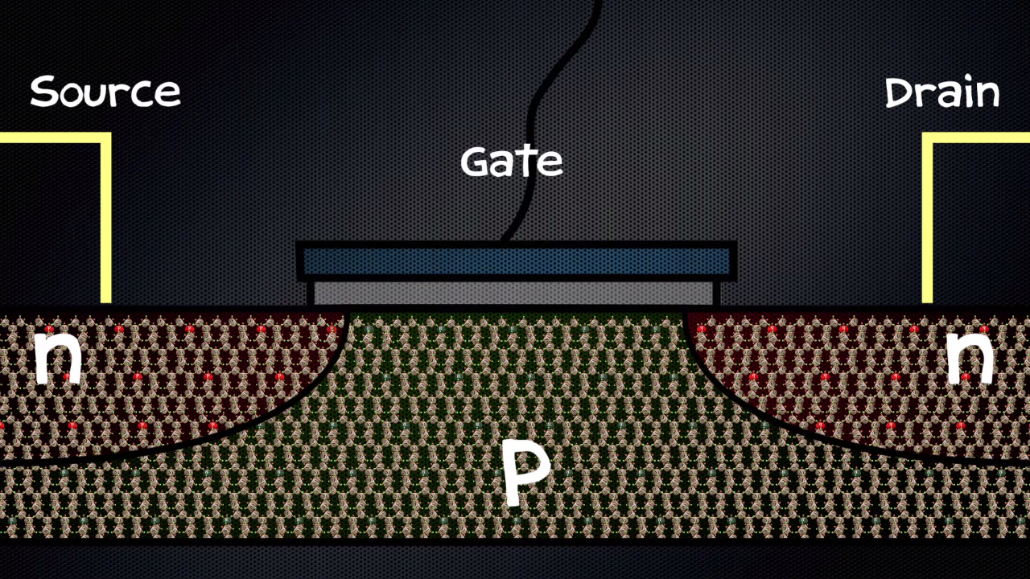
NPN transistor
Notes:
Let’s see how the transistor works in this video

Slide 20

NOT gate
$$OUT=\overline{A}$$
A | OUT
0 | 1
1 | 0
Notes:
Let’s see how the transistor works in this video

Slide 21

OR gate
$$OUT=A+B$$
A | B | OUT
0 | 0 | 0
0 | 1 | 1
1 | 0 | 1
1 | 1 | 1
Notes:
Let’s see how the transistor works in this video

Slide 22

AND gate
$$OUT=A.B$$
A | B | OUT
0 | 0 | 0
0 | 1 | 0
1 | 0 | 0
1 | 1 | 1
Notes:
Let’s see how the transistor works in this video

Slide 23


NOR gate
NAND gate
$$OUT=\overline{A+B}$$
$$OUT=\overline{A.B}$$
A | B | OUT
0 | 0 | 1
0 | 1 | 0
1 | 0 | 0
1 | 1 | 0
A | B | OUT
0 | 0 | 1
0 | 1 | 1
1 | 0 | 1
1 | 1 | 0
Notes:
Let’s see how the transistor works in this video

Slide 24


XOR gate
XNOR gate
$$OUT=A⊕B$$
$$OUT=\overline{A⊕B}$$
A | B | OUT
0 | 0 | 0
0 | 1 | 1
1 | 0 | 1
1 | 1 | 0
A | B | OUT
0 | 0 | 1
0 | 1 | 0
1 | 0 | 0
1 | 1 | 1
Notes:
Let’s see how the transistor works in this video

Slide 25
Shift Operations
x << y
0 1 1 0 0 0 1 0
0 0
1 1 1 0 0 0 1 0
0 0

Slide 26
Shift Operations
x >> y
0 0
0 1 1 0 0 0 1 0
0 0
0 1 1 0 0 0 1 0

Slide 27
Shift Operations
Arithmetic x >> y
1 1
1 1 1 0 0 0 1 0
0 0
0 1 1 0 0 0 1 0

Slide 28
To do
Read section 2.1
Watch the lectures in advance “Bits, Bytes, and Ints: Part 1”
http://www.cs.cmu.edu/afs/cs/academic/
class/15213-f15/www/schedule.html

